Slide 1

Processing Solar Images to Forecast Coronal Mass Ejections using Artificial Intelligence Savvas Raptis KU Leuven, Centre for Mathematical Plasma Astrophysics
Supervisors:
Giovanni Lapenta, Jorge Amaya

Slide 2
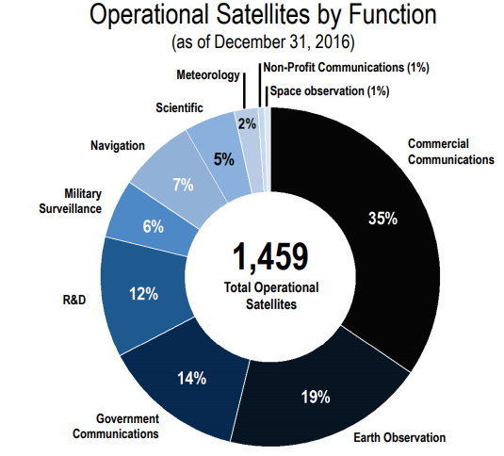

Preventing a disaster
If Satellites Stop:
No Telecommunications
No Military surveillance
No Weather forecast
No GPS
*Figure Courtesy: SIA (Satelite Industry Association)
Notes:
Nowadays, we rely a lot on technology. If however something messes around with that technology, we are in big trouble. Communications, GPS, travelling, pretty much everything we use to ease our everyday life will be gone. What can cause this problem along with many others ?

Slide 3
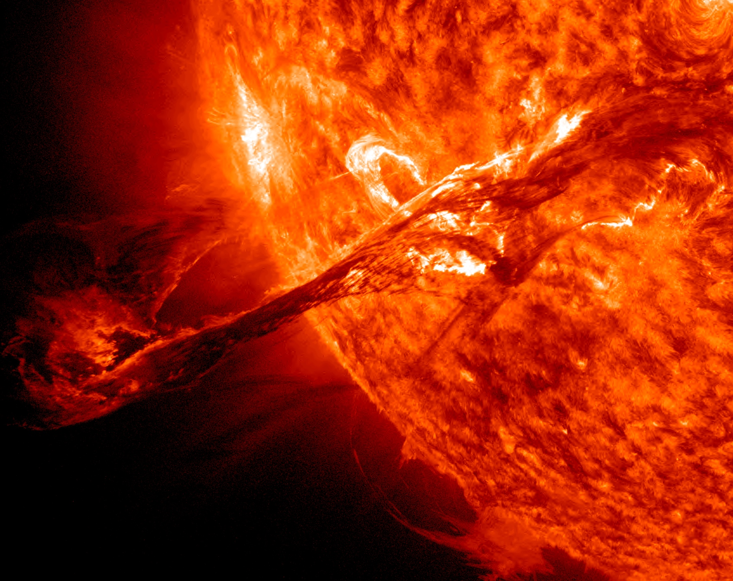
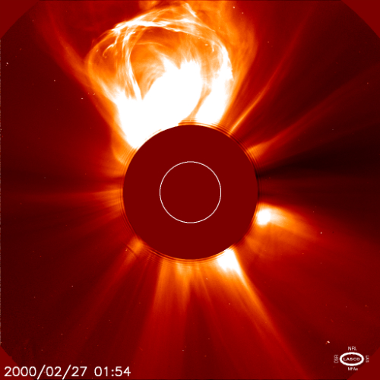
What can cause this disaster?
Coronal Mass Ejections (CMEs)
*Figure Courtesy: NASA/ESA, SDO and SOHO satellites
Notes:
Coronal mass ejections!. The phenomena we are trying to analyze and predict in this work.

Slide 4
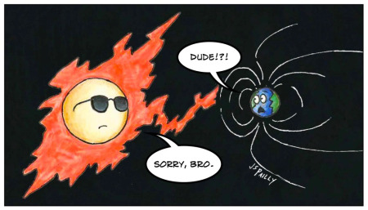
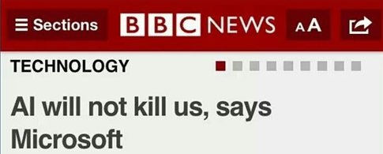
Theory
*Figure Courtesy: https://planetpailly.com/
Notes:
We are first going to talk a bit about the CMEs and then we are going to describe the tool that we want to be applied in order to predict when they are going to happen.

Slide 5
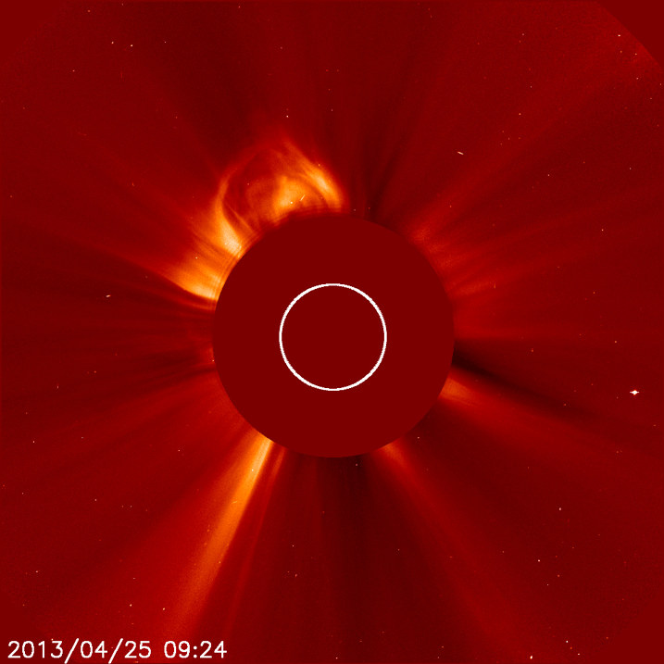
Coronal Mass Ejections – CMEs
CMEs
Energetic events from the Sun
Particles in space
+
Disturbances to Earth’s magnetic field
Problems in Satellites/Communications/Grids/infrastructures etc.
*Figure Courtesy: NASA/ESA, SOHO satellite
Notes:
CMEs are flows of plasma and particles travelling to the interplanetary space that then can cause disturbance in the magnetic field of the Earth. These disturbance can cause many troubles, a few discussed earlier regarding Satellites, but also grids, infrastructures, air travelling, space missions and many more are in danger. At this point we should state that there is a subcategory of CMEs that may be a bit more dangerous.

Slide 6
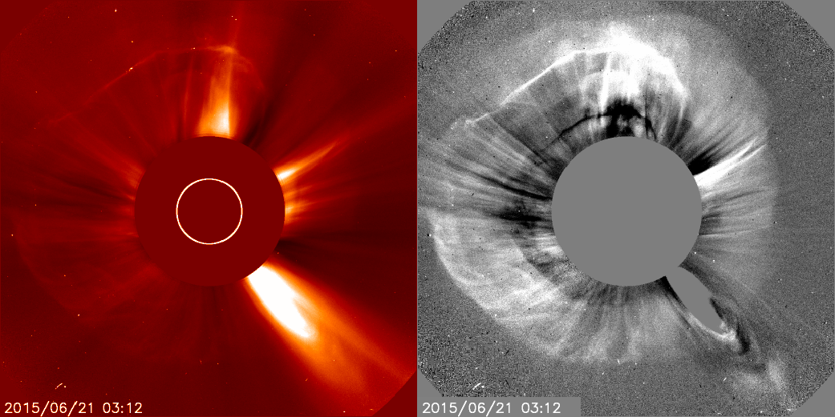
Halo CMEs
Halo CMEs
Earth-directed CMEs. Can be seen from coronagraph.
Why important?
Going to Earth
More effects on mankind
*Figure Courtesy: NASA/ESA, SOHO satellite
Notes:
Halo CMEs are the CMEs are propagating in the line of Sun-Earth. As a result they are more geoffective and in principle may have more catastrophic results. Since we described the events that we predicted in this work, let’s switch to the method

Slide 7
What is machine learning & A.I ?
Making the computer “learn” from data without being explicitly programmed
Notes:
Machine learning

Slide 8
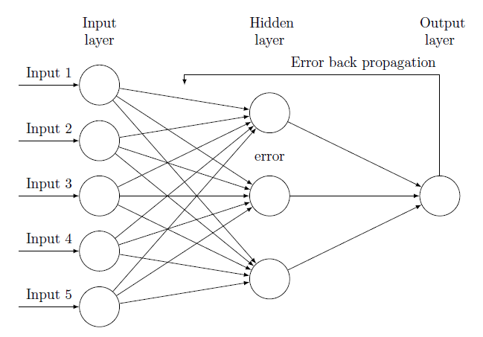
Neural Networks & Backpropagation
Output

Slide 9
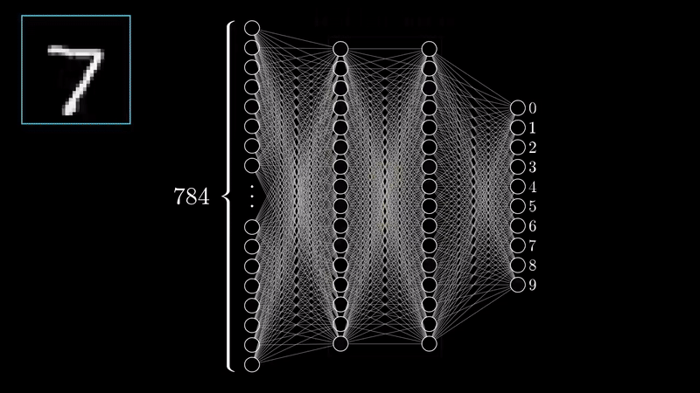
Visualization of Neural Network
*Video Courtesy: 3Blue1Brown (Check him on YouTube!)

Slide 10
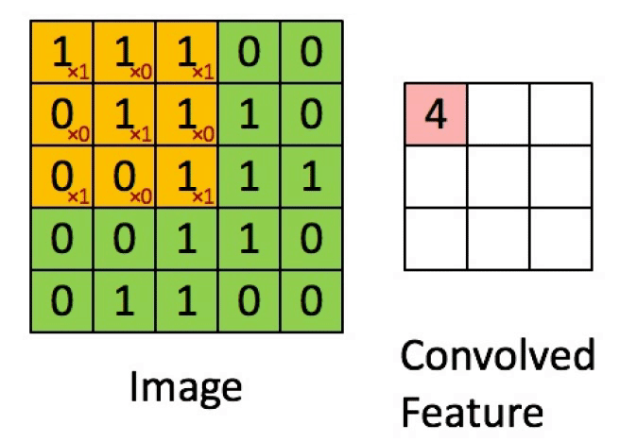

Convolution Neural Network (CNN) Layers
Convolution
Extract features & Keep spatial relationship
Pooling/Subsampling
Reduce dimensionality & retain information
*Figure Courtesy: Erik Reppel
*Figure Courtesy: Cambridge Spark Ltd

Slide 11
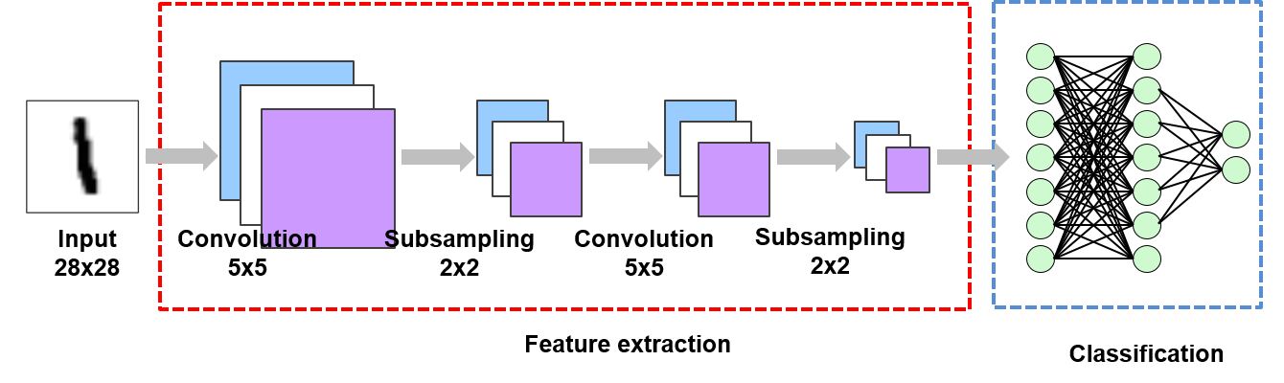
Example of CNN
*Figure Courtesy: Suhyun Kim iSystems Design Labs

Slide 12
Analysis

Slide 13
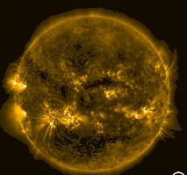
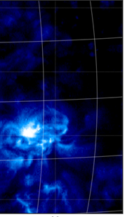
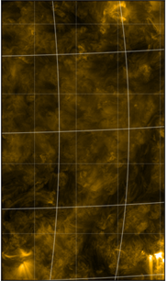
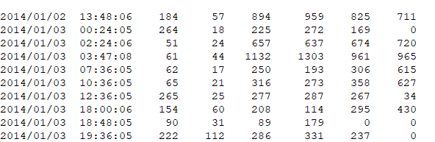
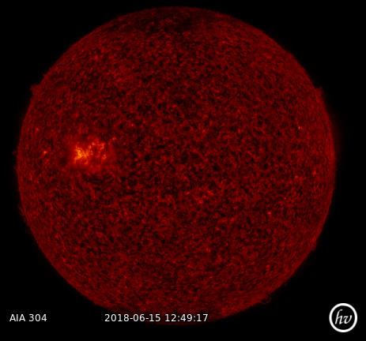
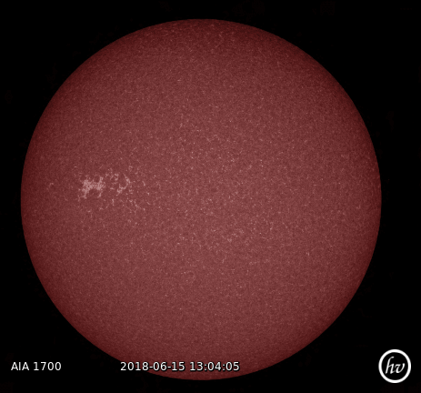
Main Goal
Forecast the emerged CMEs using solar images taken from SDO and CNN
Input
SDO Images during 2014
Output
LASCO/CACTUS Catalogs
Date
Characteristics

Slide 14
1st Part
2nd Part
3rd Part
Data Enhancement
CNN implementation
Pre-processing Tool & History Maps
Machine Learning Project
Improving Input Project

Slide 15
1st Part
2nd Part
3rd Part
Data Enhancement
CNN implementation
Pre-processing Tool & History Maps

Slide 16
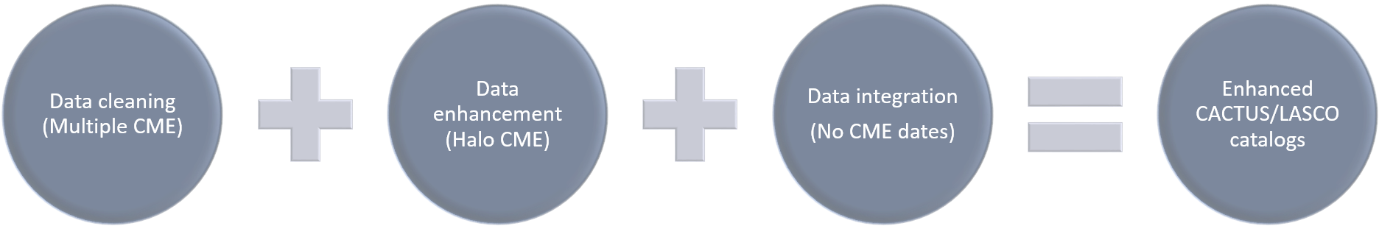
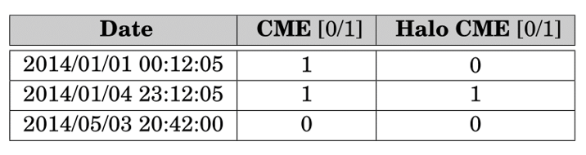


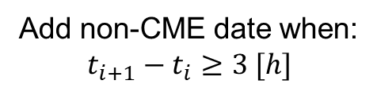
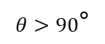
The Data Enhancement Project
Add non-CME date when:
$$t_{i+1}−t_{i}≥3 [h]$$
$$θ>90\text{°}$$

Slide 17
1st Part
2nd Part
3rd Part
Data Enhancement
CNN implementation
Pre-processing Tool & History Maps

Slide 18
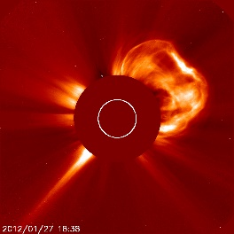

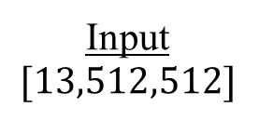

The Machine Learning Project
Input
$$[13,512,512]$$
Convolution Neural Network
Feature Extraction
Dense Neural Network
Classification
Output
CME / No CME
Conv
Conv
Conv
Pool
Conv
Conv
Conv
CME
$$…$$
$$…$$
No CME
Input = 13 SDO images, 2 [h] history before the event.
Output = 1/0

Slide 19
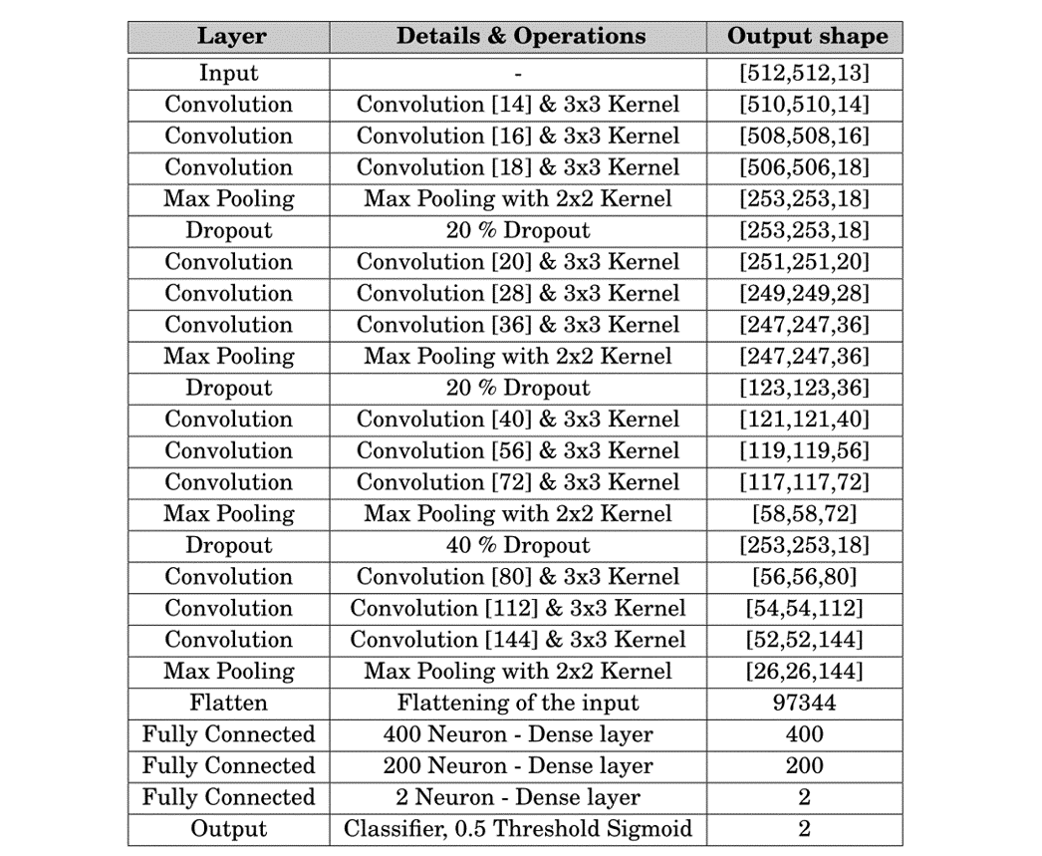
Final CNN architecture
CME
No CME

Slide 20
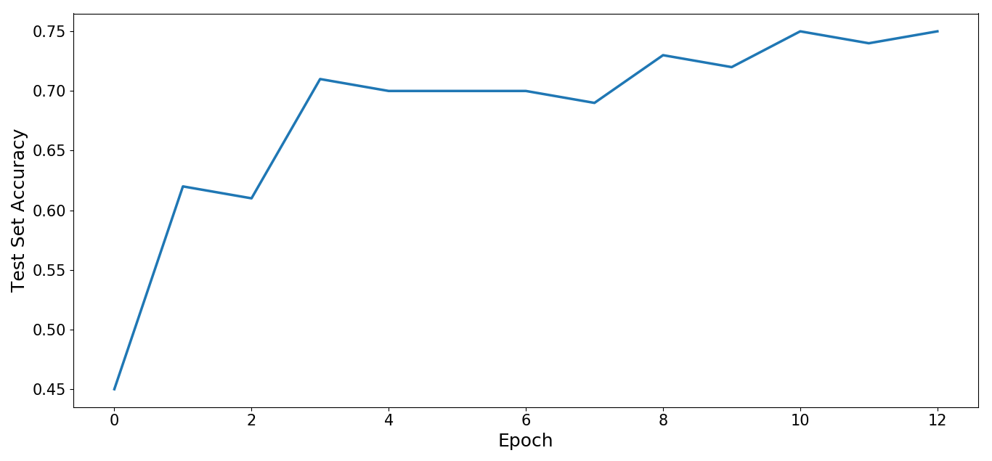
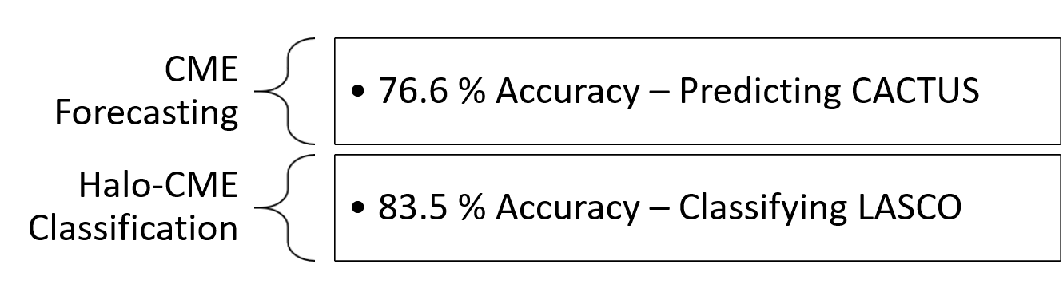
Result of CNN

Slide 21
1st Part
2nd Part
3rd Part
Data Enhancement
CNN implementation
Pre-processing Tool & History Maps

Slide 22
Pre-processing Tool – Motivation
Previous input
(+) Promising results.
(-) Expensive computationally and memory wise.
Using the pre-processing tool
(+) New input → less computational time & memory consumption.
(?) Better results.

Slide 23
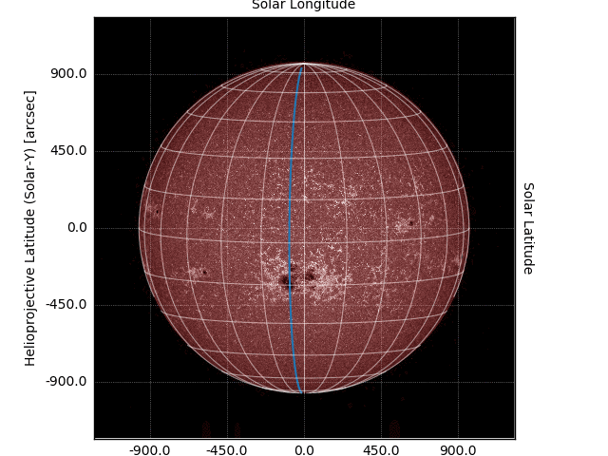
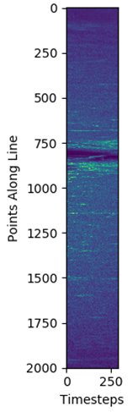
History Map (HM) – Single Line Example
HM
Same blue line, different representation

Slide 24
Pre-processing Tool – Procedure & Output
Procedure
Download data
Track Sun’s differential rotation for every longitude line
Go to next date on Catalog
Repeat
Output
Database file (.sql)
Scientific images (.FITS)
History maps (.png)
NN input (.npy)
Animation (.gif)

Slide 25
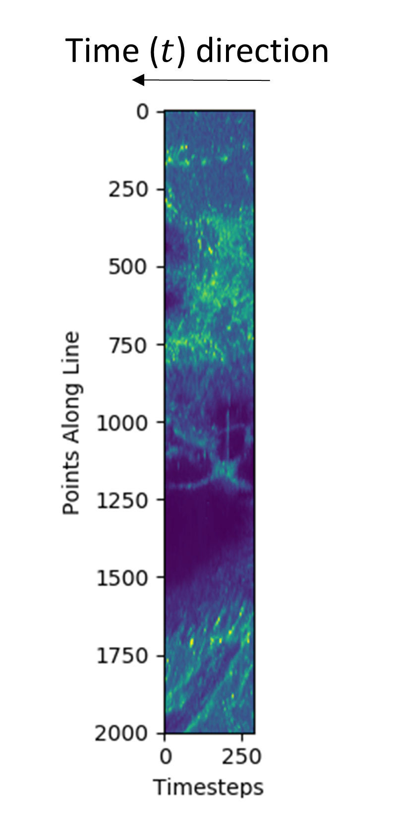
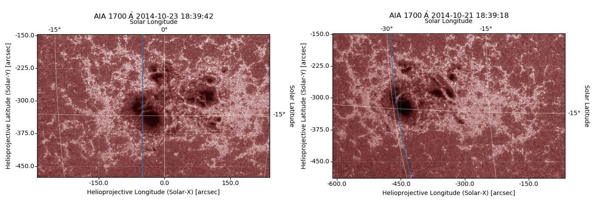
Pre-processing Tool – Sunspot

Slide 26
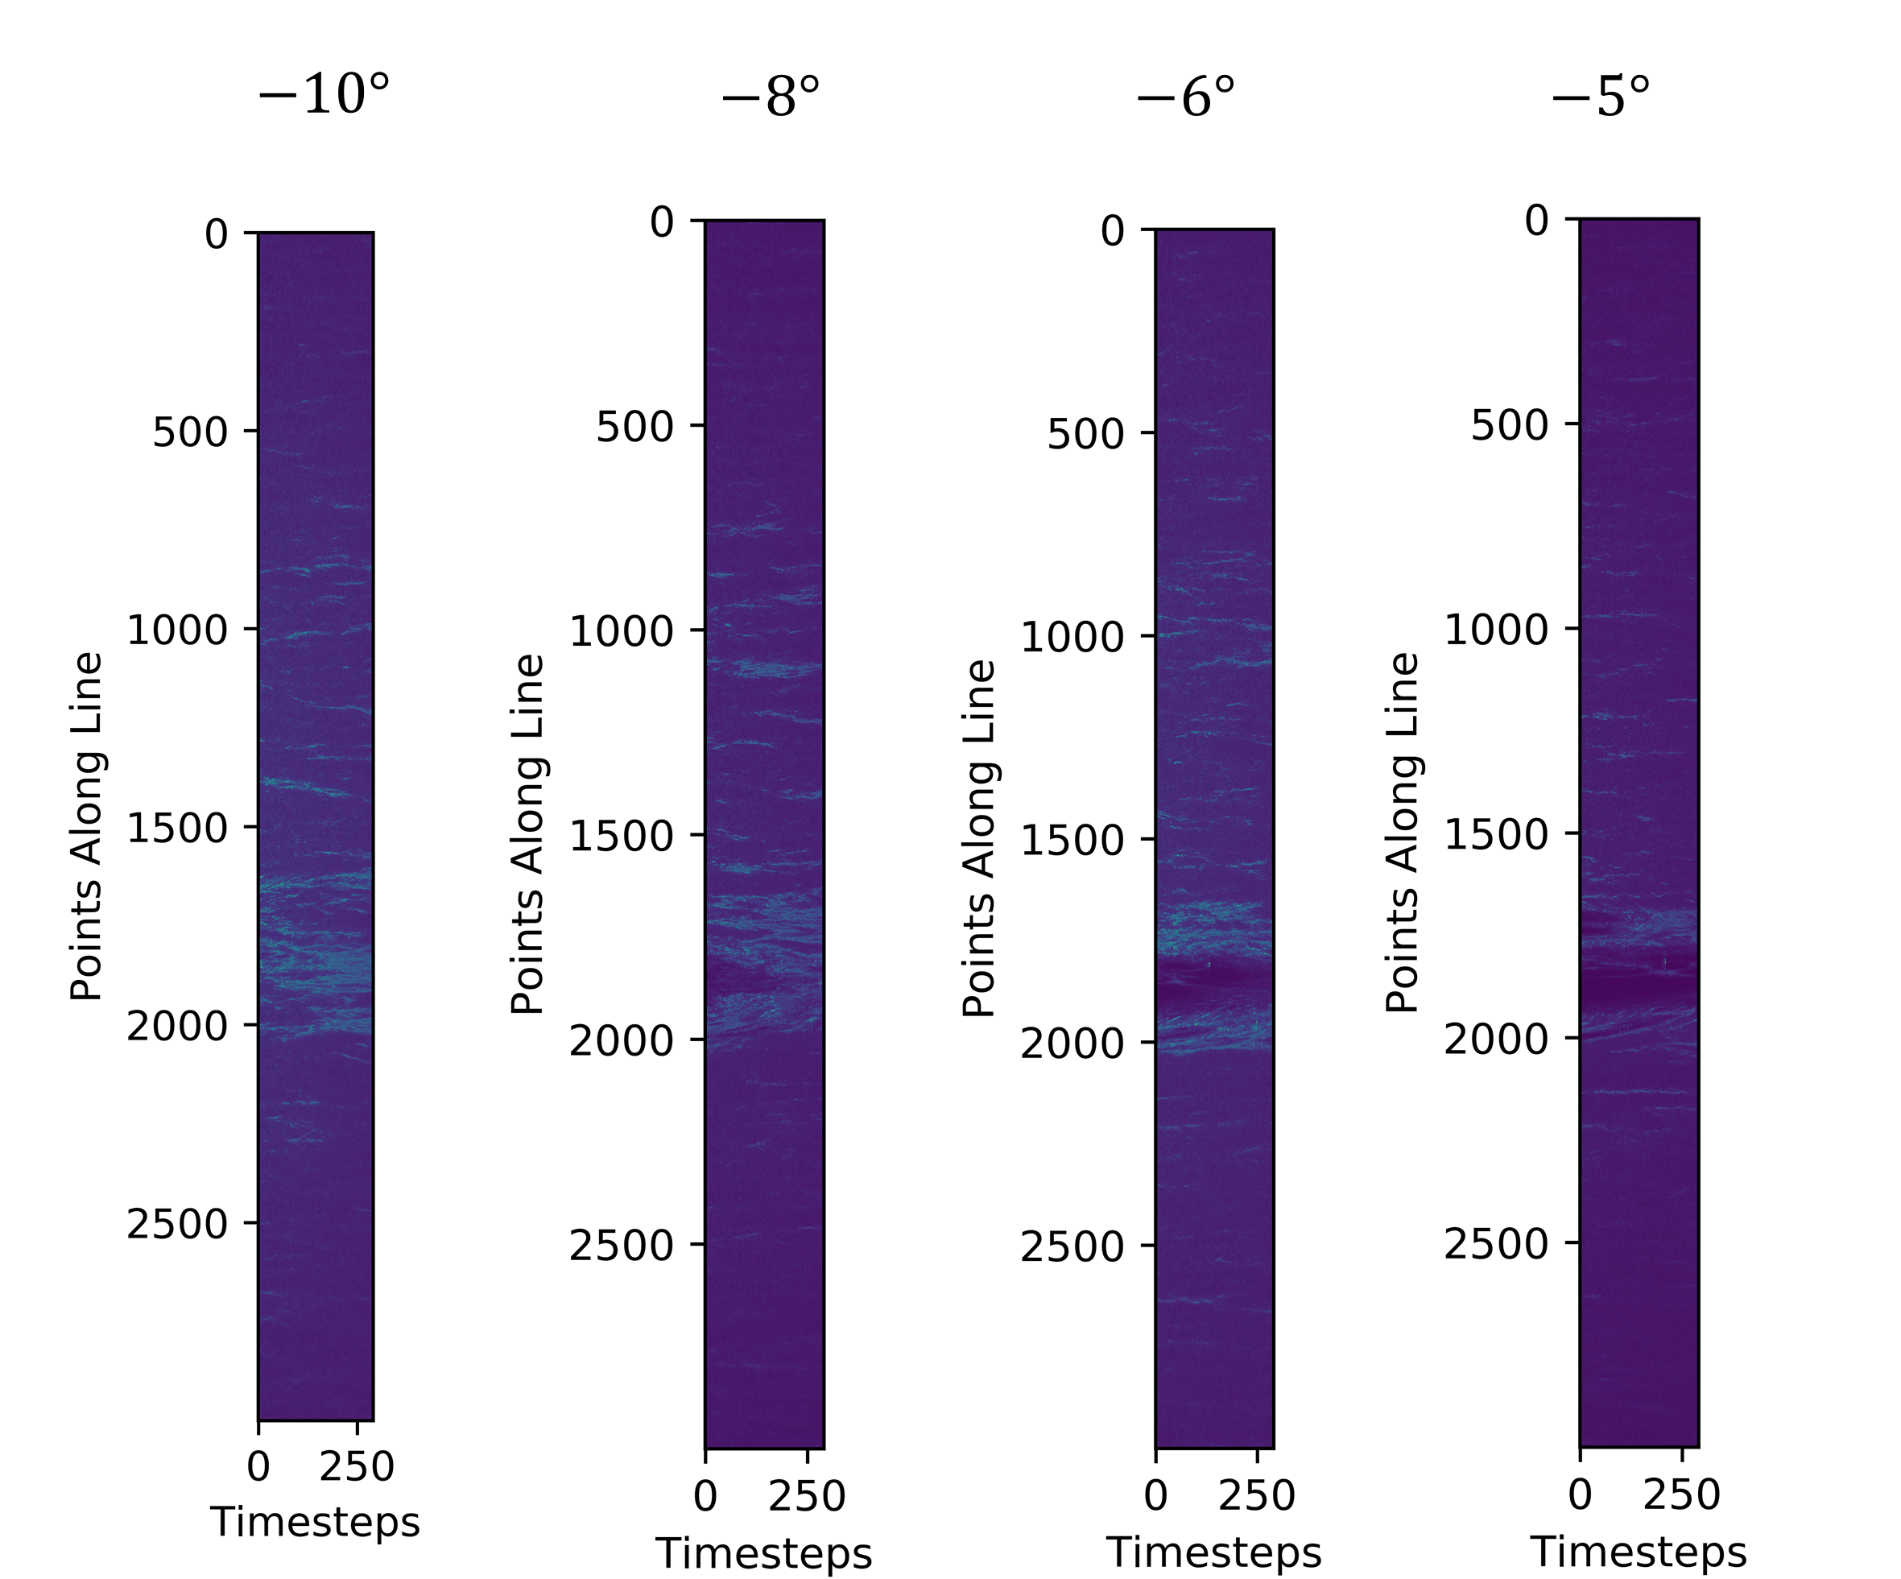
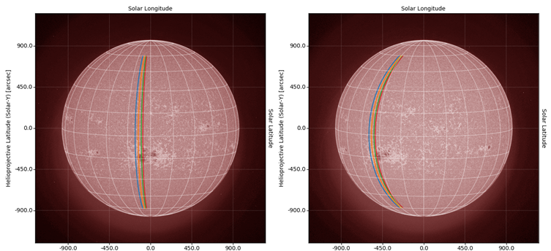
History Map – Multi Line Example

Slide 27
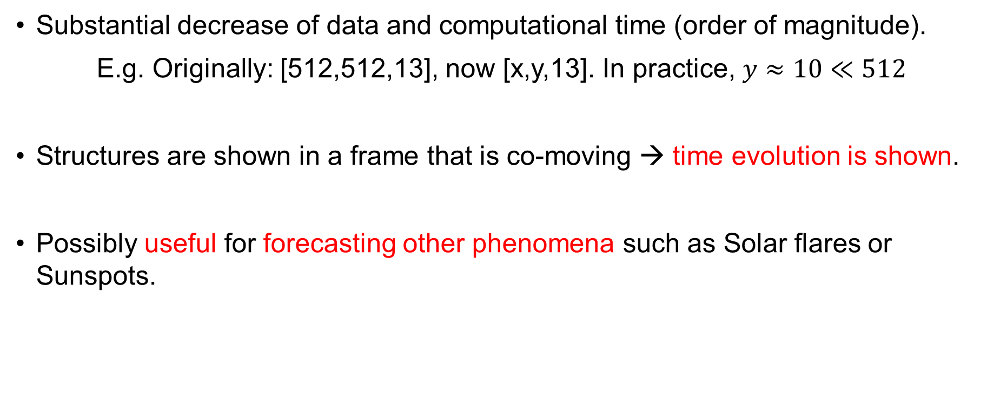
Why History Maps ?
Substantial decrease of data and computational time (order of magnitude).
E.g. Originally: [512,512,13], now [x,y,13]. In practice, $y≈10≪512$
Structures are shown in a frame that is co-moving → time evolution is shown.
Possibly useful for forecasting other phenomena such as Solar flares or Sunspots.

Slide 28
Conclusion

Slide 29
Summary
Enhanced, clean and processed SDO data and CACTUS/LASCO catalogs
Created multiple CNN models, with the best obtaining 76.6% prediction on CMEs and 83.5% classification between CME and halo-CME.
Created a pre-processing tool that derives “History Maps” (HM). Possibly useful in future Machine learning research and Solar data analysis.

Slide 30
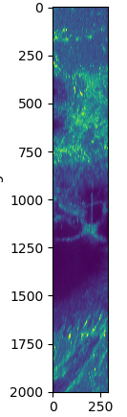

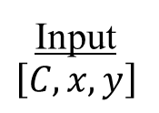

Future Proposal
Input
$$\left[C,x,y\right]$$
Convolution Neural Network
Feature Extraction
Dense Neural Network
Classification
Output
CME / No CME
History maps
Conv
Conv
Conv
Pool
Conv
Conv
Conv
CME
$$…$$
$$…$$
No CME

Slide 31
Extras

Slide 32
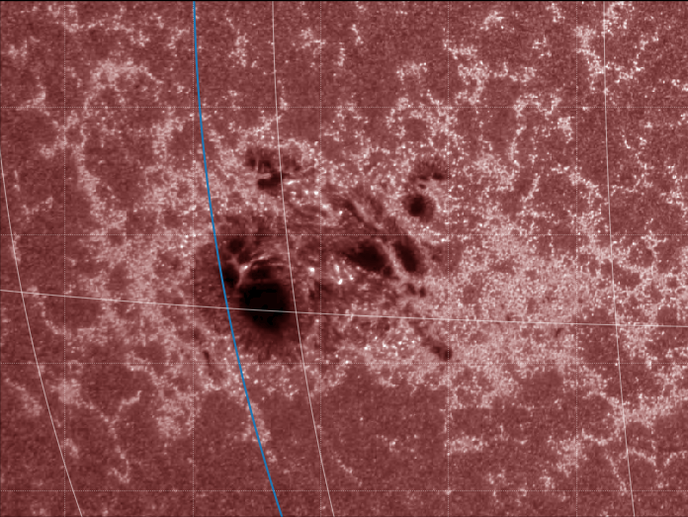
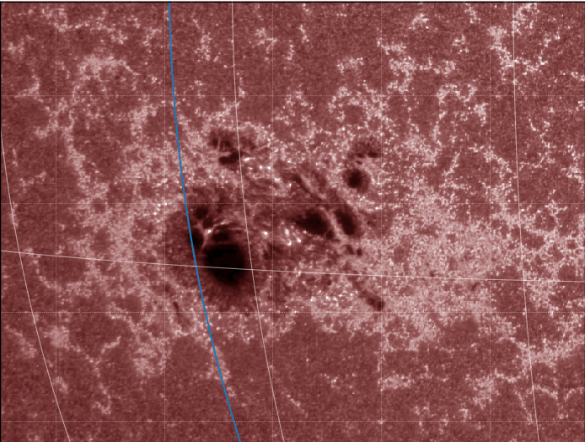
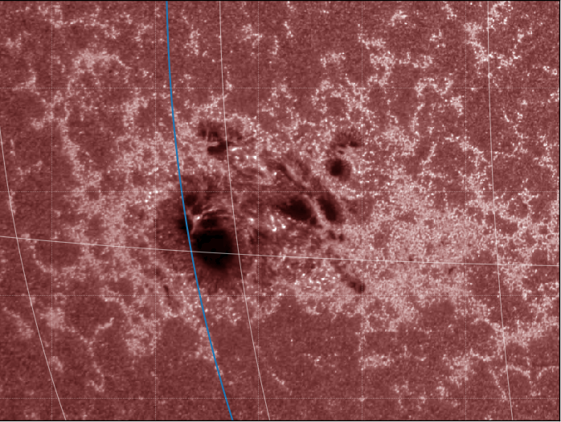
Differential Rotation Models
Allen Howard Snodgrass

Slide 33

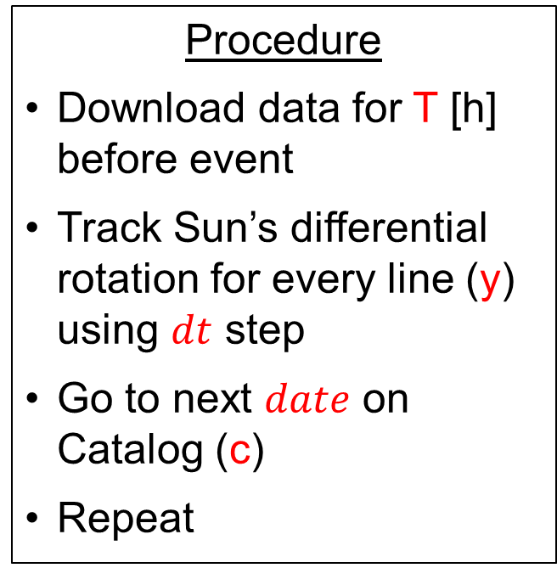
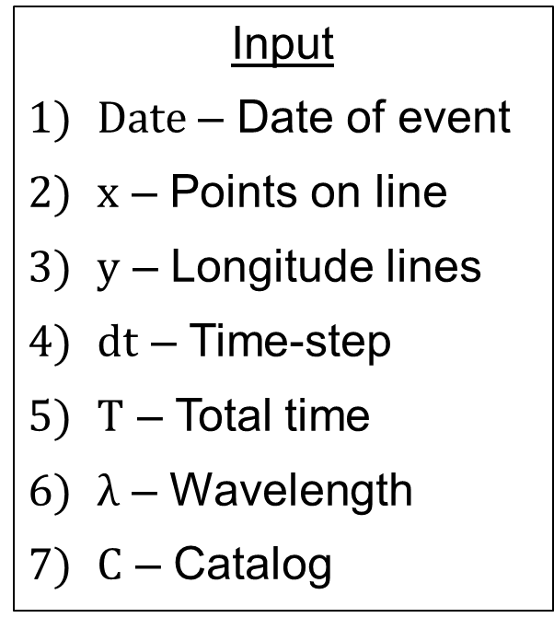
Pre-processing Tool – Design
Input
$Date$ – Date of event
$x$ – Points on line
$y$ – Longitude lines
$dt$ – Time-step
$T$ – Total time
$λ$ – Wavelength
$C$ – Catalog
Procedure
Download data for T [h] before event
Track Sun’s differential rotation for every line (y) using $dt$ step
Go to next $date$ on Catalog (c)
Repeat
Output
Database file (.sql)
Scientific images (.FITS)
History maps (.png)
NN input (.npy)
Animation (.gif)

